Slide 1
Practical lessons and resources from working in visualization and accessibility
Frank Elavsky
Notes:
Welcome, thanks so much for having me and thanks for the introduction.

Slide 2
What is design?
Notes:
As a designer, I would say that I believe I know less now about what design is and what it means to be a designer than I did 8 years ago.</p> <p>In some ways, I recognize how much I really don't know now. There is so much left to learn.</p> <p>And in a sense, I have more uncertainty now. And I mean that in the best way.

Slide 3
I am less certain than I was when I first started designing
Notes:
And that isn't because I am less confident than I was in an emotional or psychological sense. I am much more confident. </p> <p>But I have learned and matured enough to know that

Slide 4
Design is an uncertain practice
Notes:
As a designer, I don't act out of knowledge. Design decisions exist somewhere between guesswork, existing knowledge, and pure dreams.

Slide 5
All design involves a spectrum of a priori uncertainty and decision-making
Notes:
And really,</p> <p>I've been thinking a lot lately, what does it mean to design?

Slide 6
What does it mean to be a designer?
Notes:
A while ago, I was a community organizer and a student of philosophy and theology. I know, probably the most annoying two things combined into one.

Slide 7
Community organizing helped me see the power of social action
Notes:
It helped remind me that

Slide 8
Change is possible
Notes:
We can hope and anticipate a better world and work to realize that hope.</p> <p>And philosophy gave me a healthy sense of skepticism, while also helping me to recognize that

Slide 9
There are many ways of knowing
Notes:
But alas, philosophy and organizing didn't pay the bills. I'm disabled and need health insurance, so I left those behind for the tech industry.</p> <p>Fast forward 6 years or so from my organizing days and now I am a computational support specialist at Northwestern University. I was research staff and helped folks all over the university visualize their research.

Slide 10
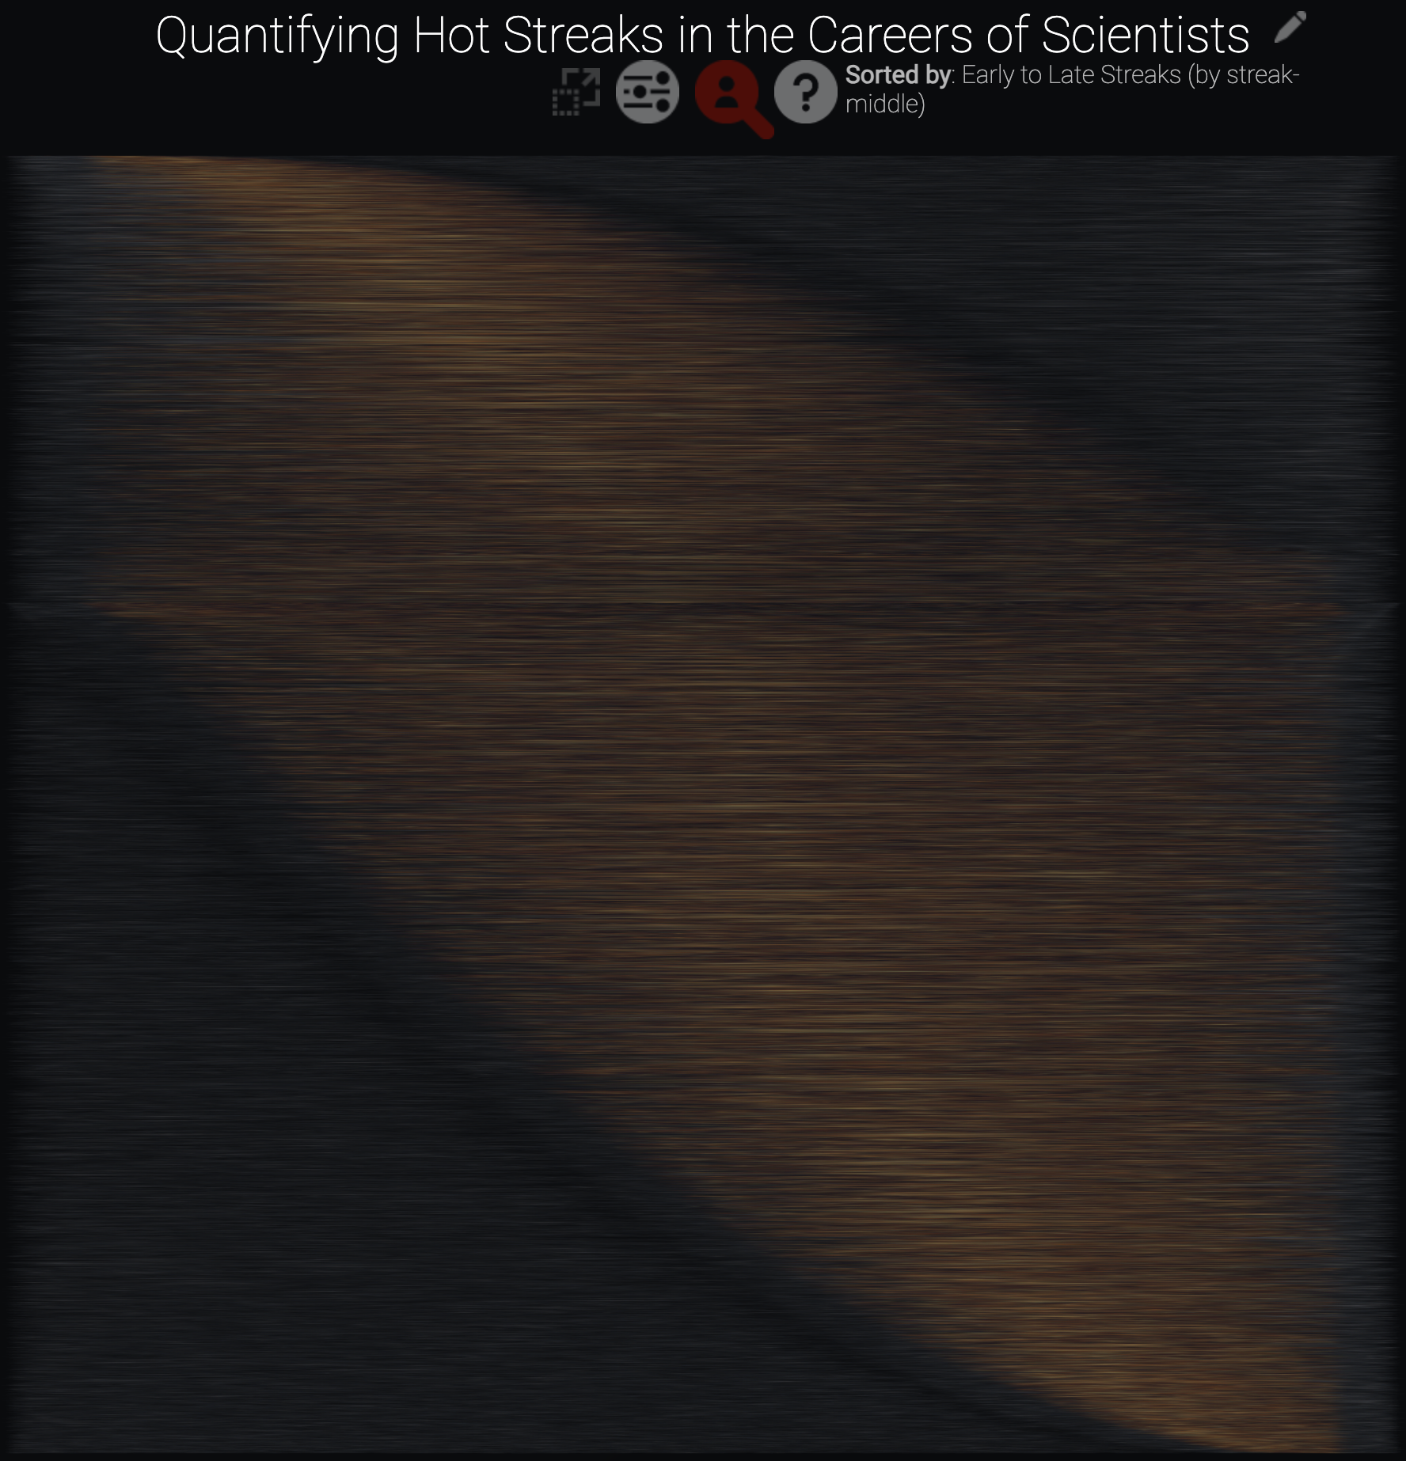
(a great technical achievement)
Notes:
Back then, I believed that I knew what good design was.</p> <p>And my projects were successful! Here in this project, I visualized over 1 million data points in SVG on the web. Technically speaking, I believed that was a good design. I was happy with it, so that must have meant that it was good, right? It was a great technical achievement and it was fun.

Slide 11
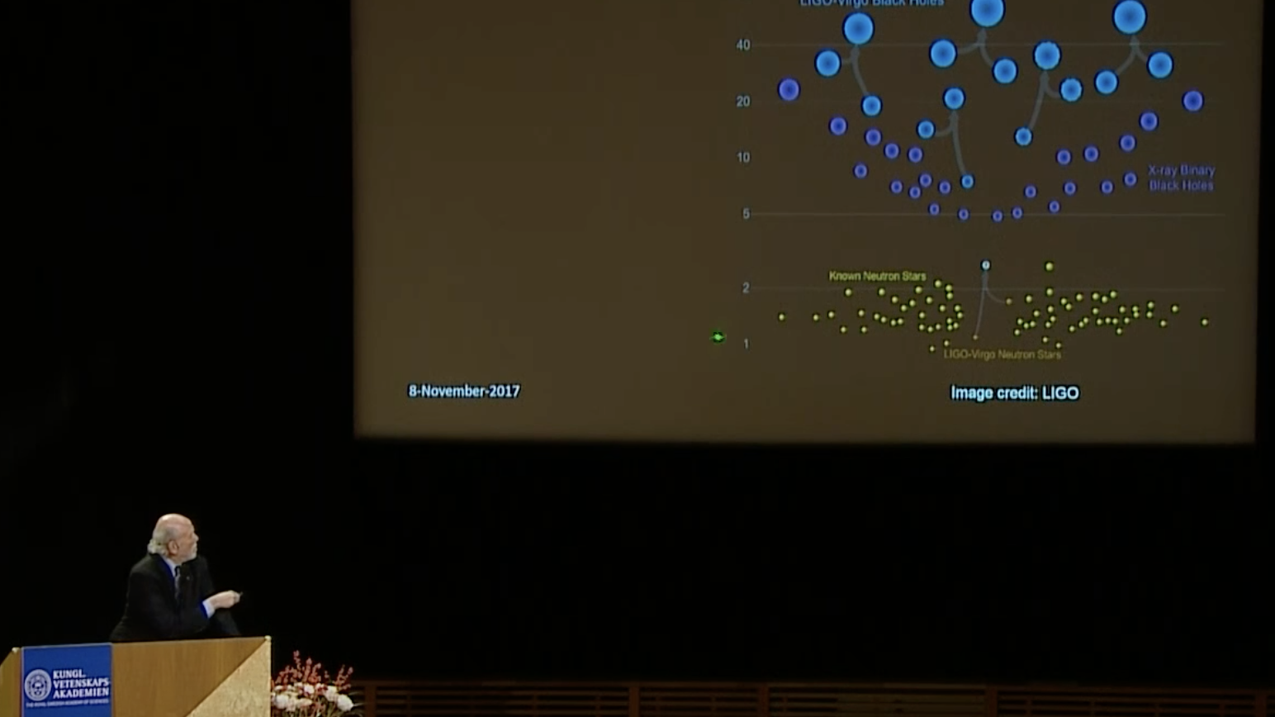
Notes:
And researchers seemed to really value my work. Here is a screenshot of the 2017 nobel lecture on physics, that is Barry Barish, the recipient, using my visualization in his talk. As far as impact goes, I believed that was good design work too.</p> <p>And not to knock on my past self too much. But back then, I was learning what I think a lot of designers learn at first: you learn how to validate what you're doing on your own terms and you learn what your immediate &quot;customers&quot; or &quot;users&quot; are interested in and find helpful or effective.

Slide 12
And then I left and got a corporate job
Notes:
At Visa</p> <p>That was great work, but I was ready for something new.</p> <p>Visa hired me to be part of a core group of staff level engineers and designers who would build a visualization charting library from scratch. This library was intended to support 2000+ developers and designers working on about 200 data products.</p> <p>I now had to design and engineer a system that <em>other</em> people used to design. An interesting new step for me!</p> <p>And I thought I had a good handle on accessibility coming into that job.

Slide 13
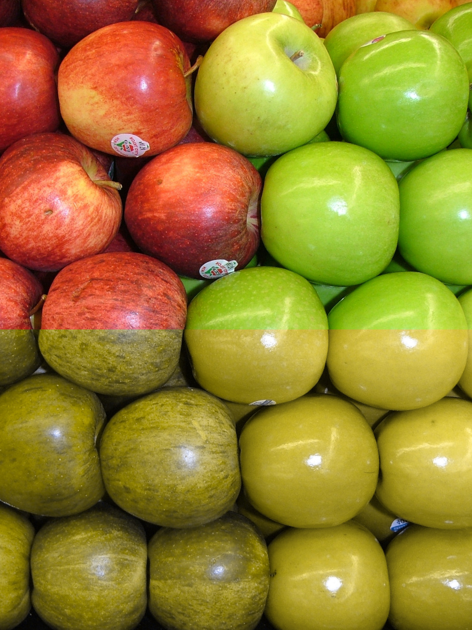
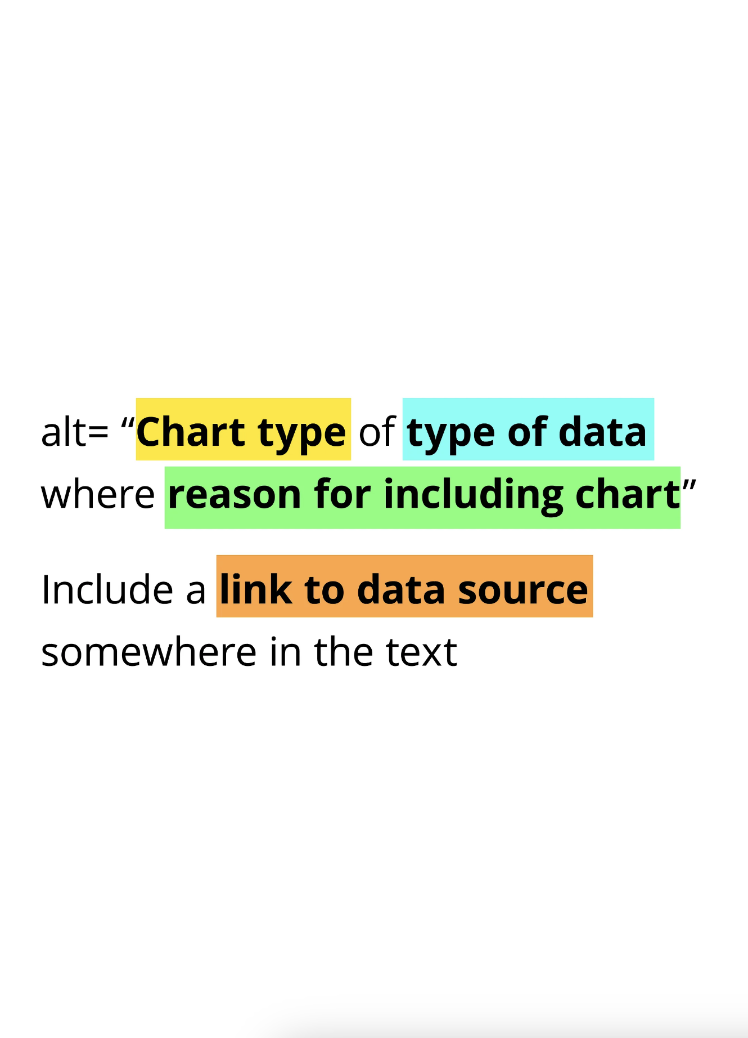
(cvd)
(alt text)
Notes:
Colorblind safe palettes and alt text were all I thought I needed to know about to do the job well.</p> <p>But Visa, a company that operates in virtually every country in the world, must comply with every country's accessibility laws.</p> <p>The VGAR (visa global accessibility requirements) included

Slide 14
126 accessibility criteria we had to pass
Notes:
By contrast,

Slide 15
WCAG (or the web content accessibility guidelines) have 78 criteria
Notes:
And our first internal accessibility audit came in. We had significant work to do.

Slide 16
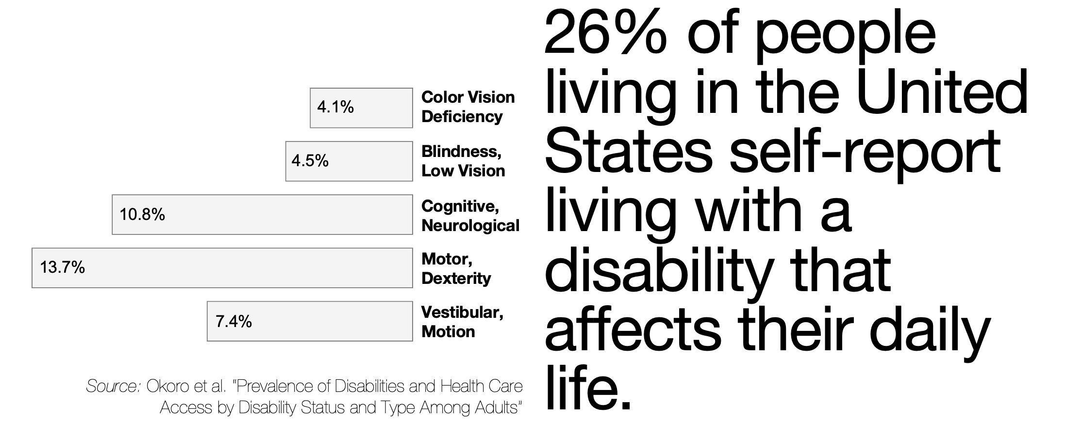
(> a quarter of all people)
Notes:
(First half of image)</p> <p>In the United States, 26% of people self-report living with a disability that affects their daily life. This is spread across a range of what are called &quot;functional&quot; categories of disability.

Slide 17
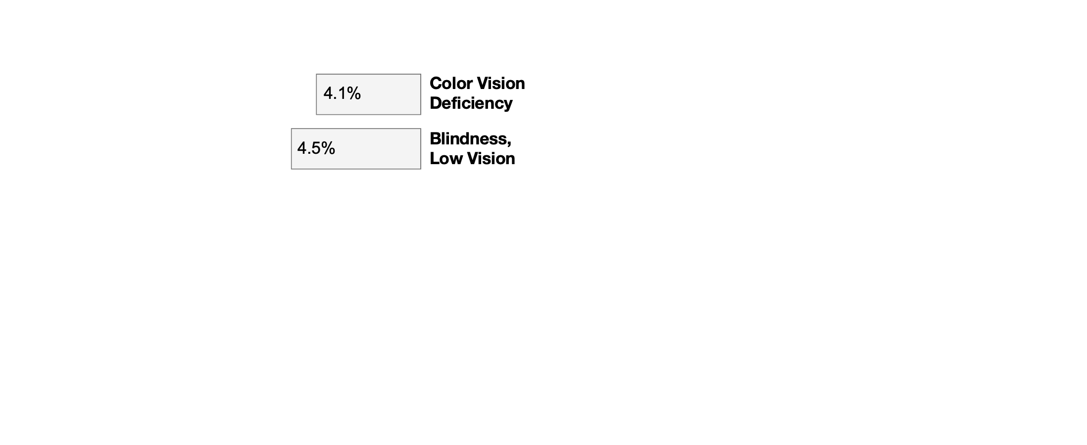
(my limited focus)
Notes:
(Simplified image focusing only on visual disabilities)</p> <p>I assumed that these were what we needed to focus on in our work, since we did data visualization.

Slide 18
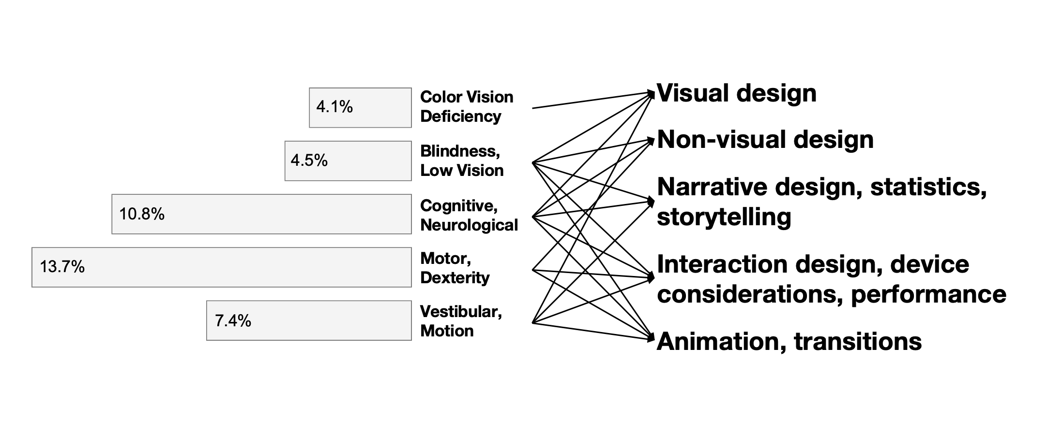
(many more barriers exist)
Notes:
(Second half of image)</p> <p>But it turns out that every functional category of disability can encounter barriers when using interactive, dynamic data visualizations.</p> <p>We were building pretty robust components that could be adjusted to fit the designs and functionality of pretty much anything you could imagine a standard chart being capable of.</p> <p>And this was a big growing up moment for me, as a designer. I encountered my biases at a scale I never imagined before.

Slide 19
My lack of knowledge had a tangible impact on who was included in visualization

Slide 20
My biases created priorities, and those excluded some people
Notes:
Now, let me talk about

Slide 21
Standards and guidelines
Notes:
For a short minute. VGAR and WCAG gave me objectives.</p> <p>And objectives can be good for design!</p> <p>It's often hard to know where to start, where you're going, and to keep everything in mind while you're doing it.</p> <p>I worked with the accessibility team closely to make sure our charting library was excellent, cutting edge even, in how we handled accessibility. I was pretty proud of it. We passed all 126 criteria! As far as comprehensive accessibility design goes, I believed I knew what was good design. It certainly checked all the boxes.

Slide 22
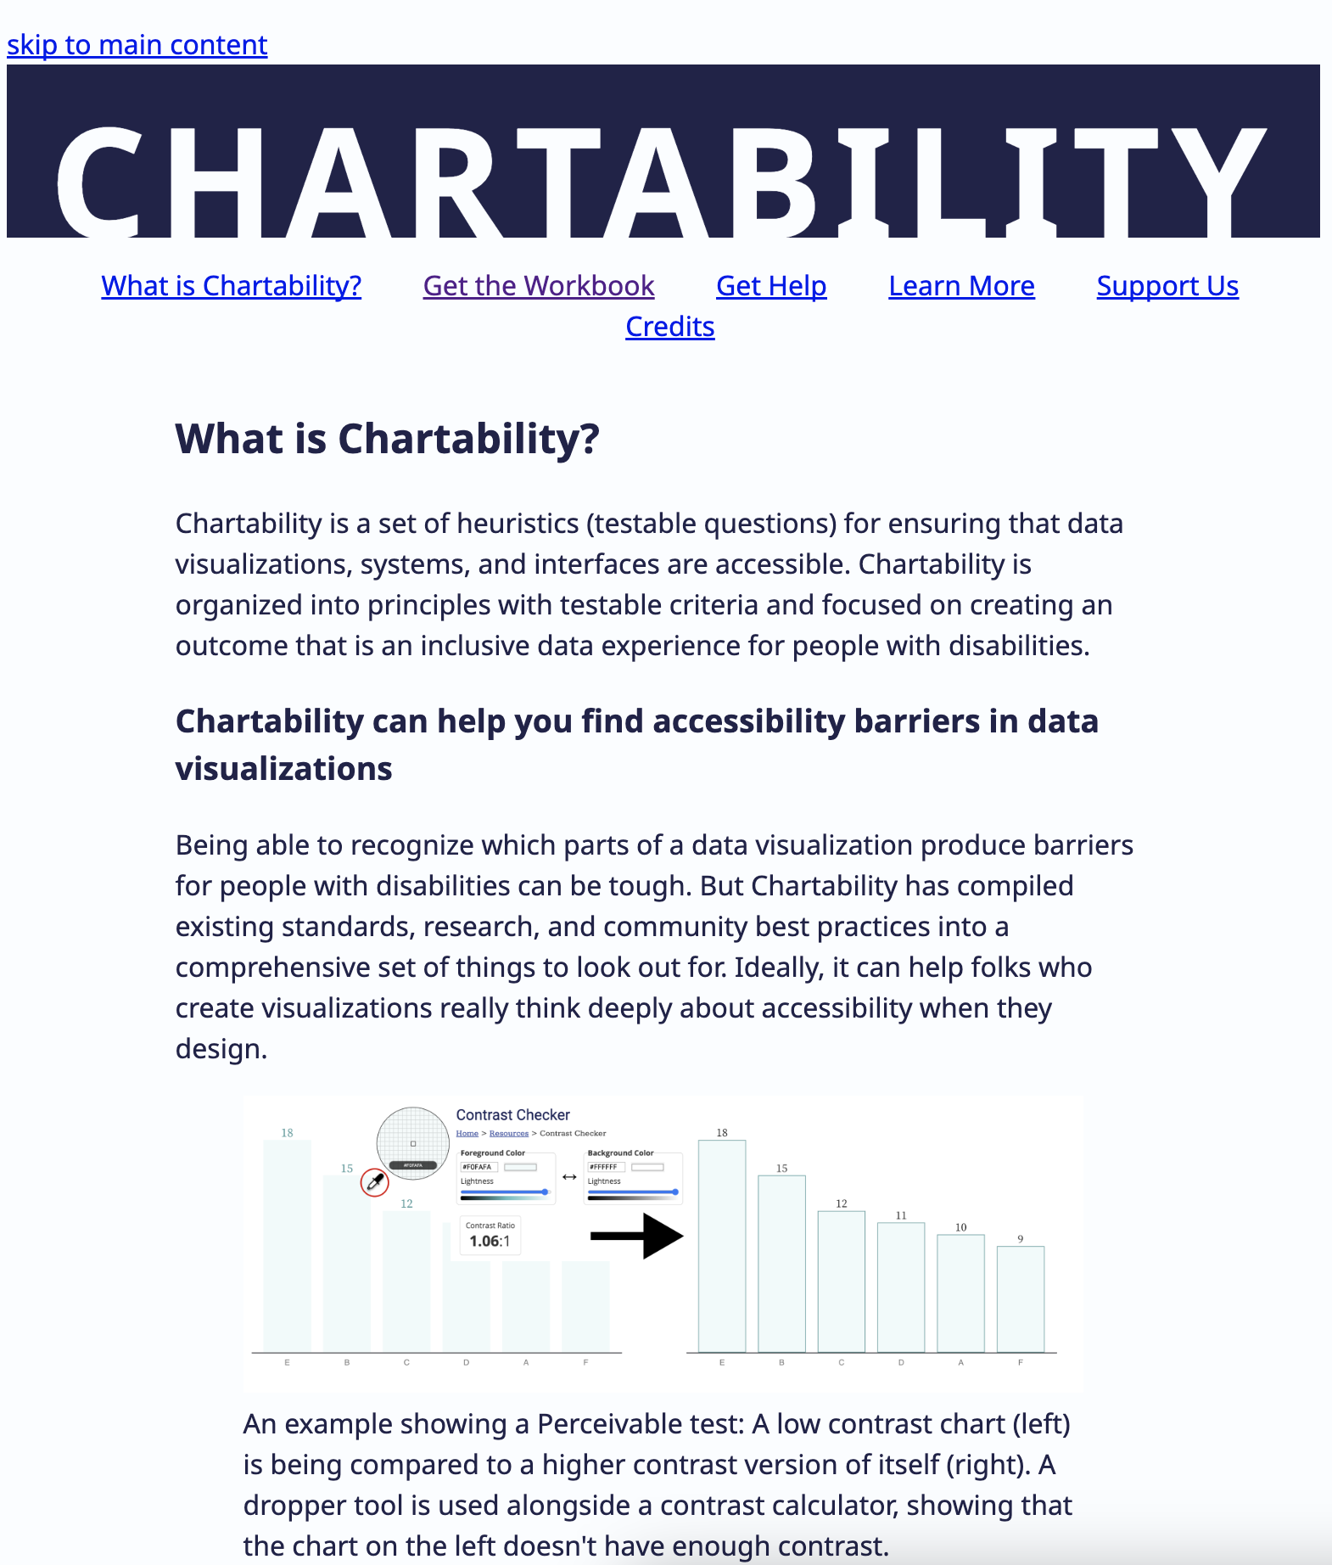
(Chartability's webpage)
Notes:
In a separate talk, perhaps I'll tell a longer story about Chartability, a relatively big project of mine that has spanned the last few years.</p> <p>This work at Visa on standards and guidelines are what inspired me to start making guidelines specific to visualization accessibility.</p> <p>But back onto my journey at Visa: All seemed well with the accessibility situation

Slide 23
Until we involved real users
Notes:
I know this is not super deep or insightful to anyone who has ever shown something they've designed to another human who is supposed to use it, but after our research sessions I quickly learned that there was a lot of room for improvement.</p> <p>We had expert users (data analysts, managers, and engineers) with disabilities help us better understand what worked and what didn't.</p> <p>And I quickly realized a few things. First, that

Slide 24
Standards and guidelines set the floor of an experience
Notes:
But they don't ensure something is really good, or effective.</p> <p>It should come as no surprise, but it turns out that people with disabilities are the ultimate source of certainty in accessibility.

Slide 25
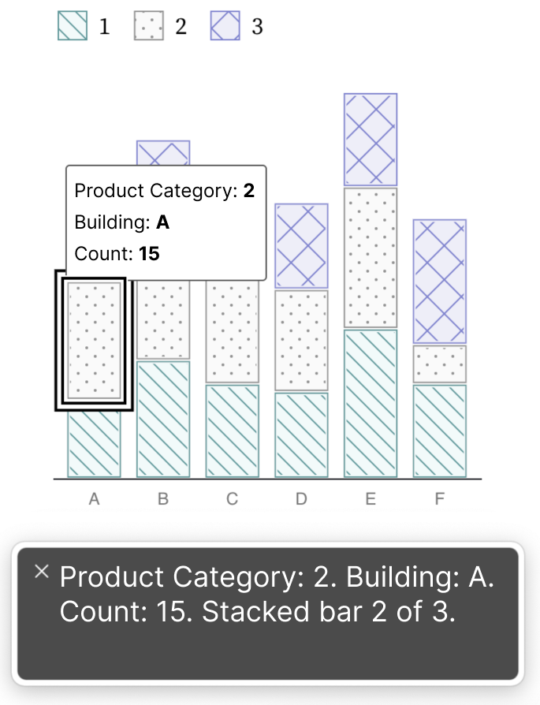
(the old)
Notes:
An example of this is on the left I'm showing how we might describe a single bar inside of a stacked bar chart. This description is visually hidden but read by technology called a screen reader. Blind folks are the most common users of screen readers, but are not the only ones.</p> <p>The text at the bottom shows the screen reader announcing Product Category: 2. Building: A. Count: 15. Stacked bar 2 of 3. This matches the visual tooltip on the chart.</p> <p>And it turns out that blind folks who are expert analysts want information a lot faster than this. Native screen reader users often have their screen readers on very fast speed settings so that they can consume information as quickly as possible.

Slide 26
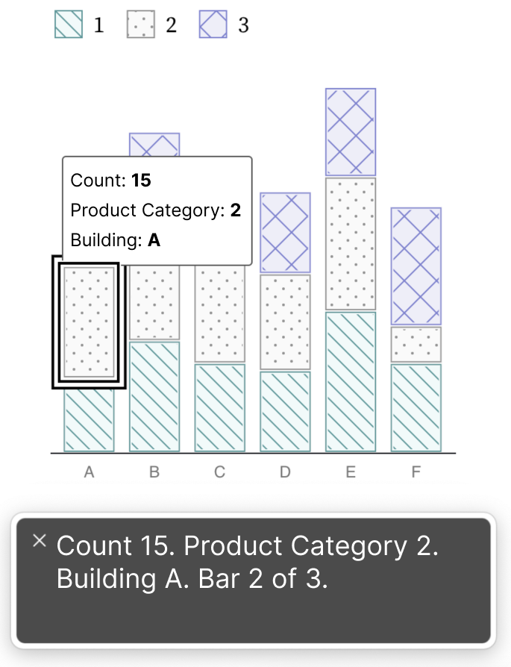
(the old)
(improved)
Notes:
So this design worked much better for them. On the right, we've trimmed excess punctuation (which can often pause a screen reader) and made sure the most important information for understanding trends and comparisons came first in this string of text. When just trying to compare values, we dramatically sped up the time it would take them to make a comparison or dig for trends and patterns.</p> <p>This example with text for screen reader users is just one tiny piece of design too, and it makes a huge difference.</p> <p>Standards, the floor of experience, only get us so far.

Slide 27
Users teach us what a good experience is
Notes:
Involving users with disabilities as early as possible, even as co-designers has been my practice lately.</p> <p>After my time at Visa, I've since done quite a lot of consulting. And there is an emerging thing I've learned from people with different disabilities. And that is that

Slide 28
Accessibility for some is a barrier to another

Slide 29
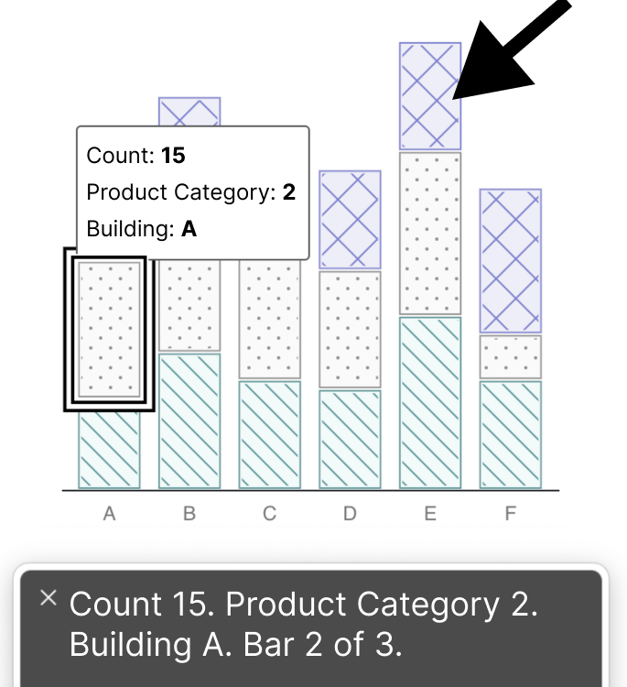
(chart textures can be a barrier for some!)
Notes:
Just one example of this are chart textures. These patterns we put on charts, which we do because it is a standard requirement, might also become a barrier for folks with certain visual and cognitive disabilities. It adds complexity.</p> <p>This happens a lot in design. In fact, data visualization itself is an attempt to make data more accessible for sighted individuals at the cost of losing textual richness that a screen reader user could access.

Slide 30
A single, static design simply cannot always be accessible for everyone.
Notes:
In disability spaces, &quot;Accessibility for some that is a barrier to another&quot; is called

Slide 31
"Access friction"
Notes:
Access friction is surprisingly under discussed in contemporary accessibility contexts (despite being common in spaces occupied by people with disabilities).</p> <p>And why might that be the case?

Slide 32
Access frictions challenge the notion of standardized access
Notes:
People with disabilities talking about their real experiences should have precedence over everything else, right? Even standards?</p> <p>Unfortunately, not in practice. Navigating access frictions will likely bring an entirely new generation of thought on accessibility in practice.</p> <p>So at the beginning of this talk, I remarked that as a designer, I don't act out of knowledge</p> <p>And I was being a bit tricky because in a way, I actually do. I've just always acted out of the knowledge I had at the time, even though now, afterwards, I can see that there was always far more that I didn't know than I thought I did.</p> <p>I act out of knowledge but I act MORESO out of uncertainty and a <em>lack</em> of knowledge.

Slide 33
I don't know what I don't know
Notes:
But

Slide 34
I'm pretty certain I don't know a lot of things
Notes:
So first I believed I was certain because my designs worked for me.</p> <p>Then, I was certain because others found them useful.</p> <p>Then I was certain because I had really comprehensive guidelines.</p> <p>And lastly, I was certain because what worked for a subset of a population should surely generalize if we have an adequate sample size.</p> <p>But of course,

Slide 35
Access frictions bring us back to uncertainty

Slide 36
Designing is a way of knowing
Notes:
And so </p> <p>Now, I expect uncertainty.</p> <p>And in fact, the most important part of design to me now is this anticipation that I experience. I am anticipating what happens <em>after</em> I design: I might find an opportunity to learn something new</p> <p>So now, to me I've learned that

Slide 37
Design is an act of anticipation
Notes:
And if I accept that and take a step back…</p> <p>I see two kinds of design before me: designing that builds on my certainties, this is design that is slowly congealing into a model:

Slide 38

patterns...
Notes:
past experiences that become patterns can help us

Slide 39

...can help us predict
Notes:
predict what to do in new contexts.</p> <p>In this sense,

Slide 40
Model-building is a conservative act.
Notes:
The goal is to increase certainty and reduce risk: we use the past to try to predict the future.</p> <p>But seeing patterns emerge and models form also shows another kind of design:

Slide 41

the empty space
Notes:
the gaps. The empty space. The anti-models and the excluded things. The places we haven't been. The <em>uncharted</em> territory (pun intended of course). There is more uncharted than charted territory out there.</p> <p>It occurred to me, if so much of what I do isn't actually truly certain.</p> <p>Why not seek out those places we haven't been?

Slide 42
Is the a better world always going to be built out of what we have already seen and done before?
Notes:
Looking forward, two examples of uncharted territory for me are both related to access friction:</p> <p>In my story, I am the designer. That is a common data point. If I was building a model, I'd predict that I'd continue to be the designer.</p> <p>But what if in the future, I wasn't? What if we could design systems and experiences that give users the tools and resources to design for themselves?</p> <p>What if we could explore a sort of

Slide 43
"End-user design"?
Notes:
I have a lot of uncertainty there, but I anticipate empowering users to enact change is part of a better world.</p> <p>And the second idea I have for the future might be something that helps us realize end-user design, what I'm calling

Slide 44
"Softer materials"

Slide 45
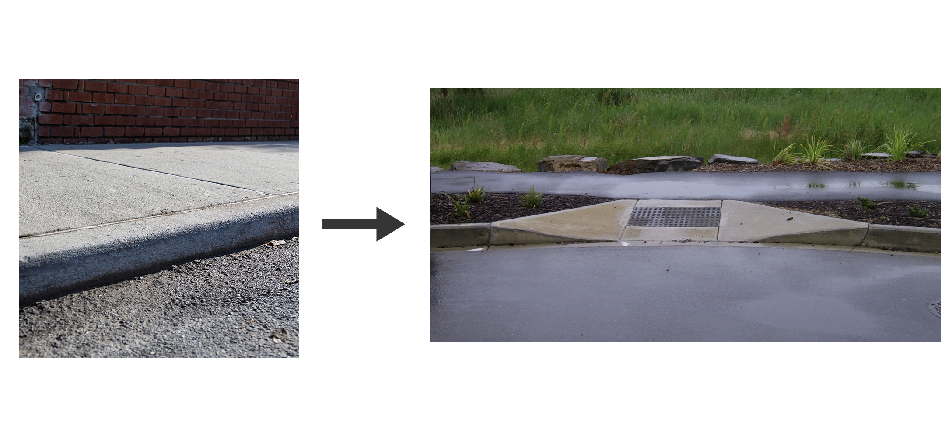
cutting curbs
Notes:
In contrast, concrete, and specifically concrete curbs, have been a tension point in disability advocacy, thought, and research for almost 60 years now. Concrete is physically hard. It is a tough material. We have to smash it and rebuild it when we want to cut curbs. Making a city accessible requires breaking the old to build the new.</p> <p>But digital materials… those are much more fluid. I'd argue they are quite soft. Digital things are called <em>software</em> and not <em>hardware</em> for a reason.

Slide 46
What if we brought the soft back into software?
Notes:
What if our designs weren't static once they're done? What if others had the ability to change or morph the presentation, logic, or flow of our experiences?</p> <p>Are there opportunities there?</p> <p>I certainly anticipate that end-user design and softer materials will lose some advantages like convenience and speed compared to things made only by designers.</p> <p>But what these new ideas offer is expressivity, control, and perhaps a way to mediate access frictions.</p> <p>So to all of you, I want to encourage you to

Slide 47
Design with anticipation
Notes:
Build a better world out of what you have seen before, use standards and research and experience. But also: look to those uncharted spaces and imagine what could be.</p> <p>And of course, I hope that you all also try to make your visualizations more accessible too. Thank you.

